Slide 1
Machine Learning

Slide 2
Introduction
Artificial Intelligence
The simulation of human intelligence processes by machines, especially computer systems.
Replicate human-like cognitive functions, such as problem solving, learning, reasoning, and decision-making.

Slide 3
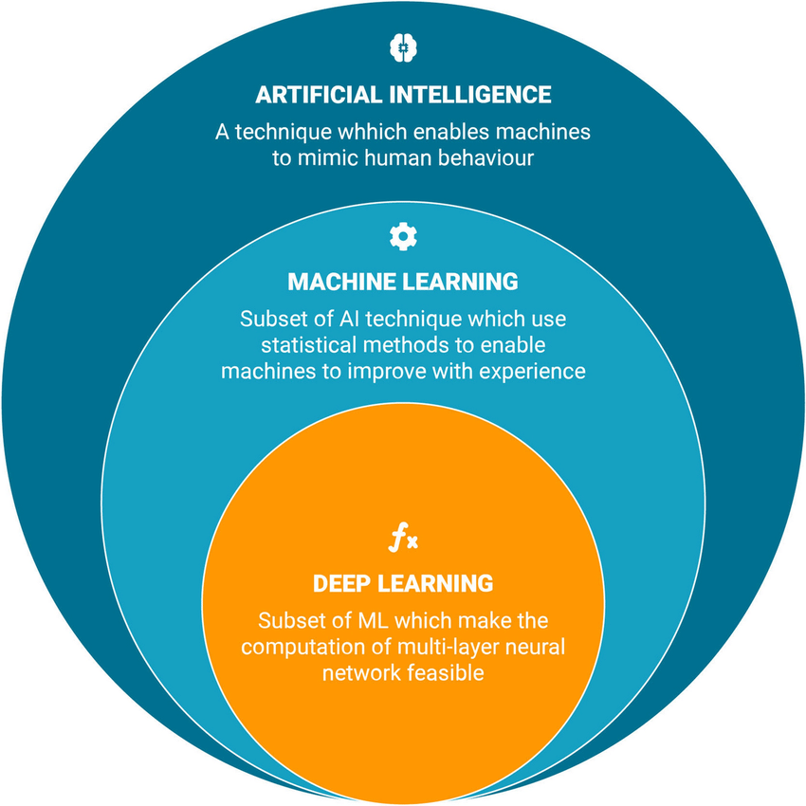
Introduction

Slide 4
What is Machine Learning?
Machine Learning is a subset of artificial intelligence that focuses on the development of algorithms enabling systems to learn patterns from data.

Slide 5
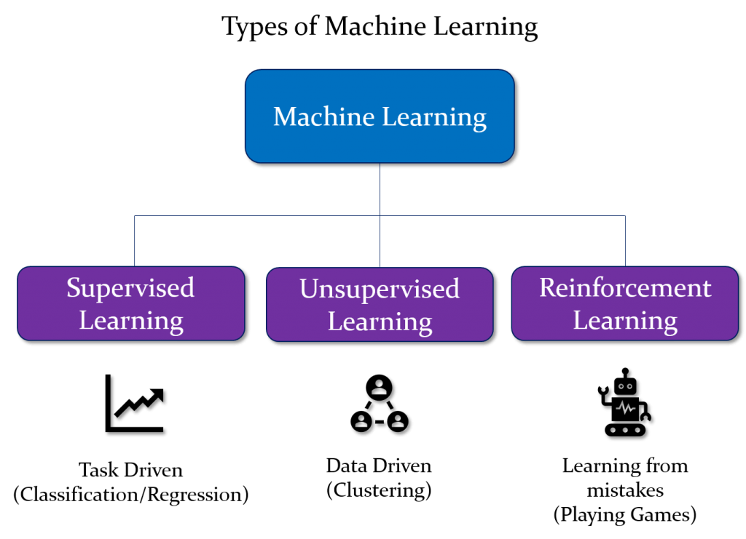
Types of Machine Learning

Slide 6
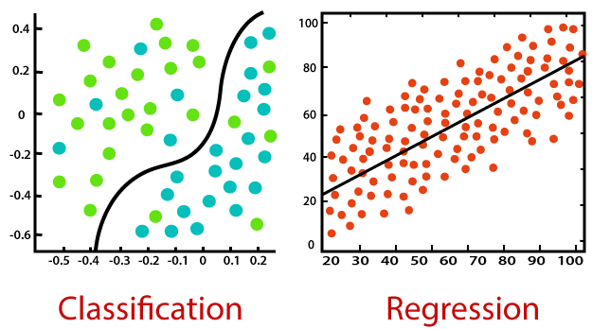
Supervised Learning

Slide 7
Linear Models

Slide 8
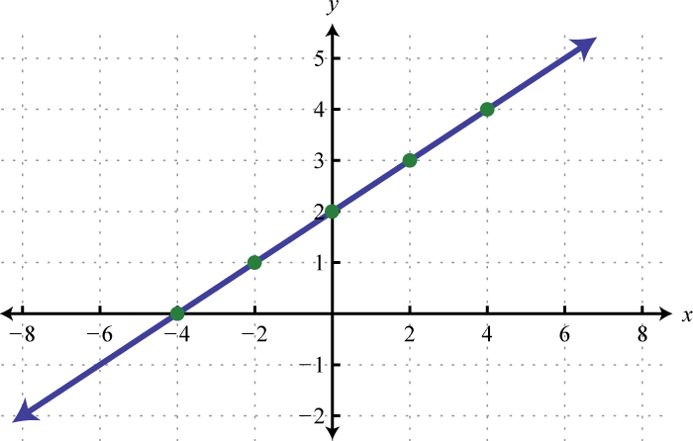
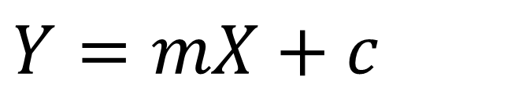
Linear Regression
$$Y=mX+c$$

Slide 9
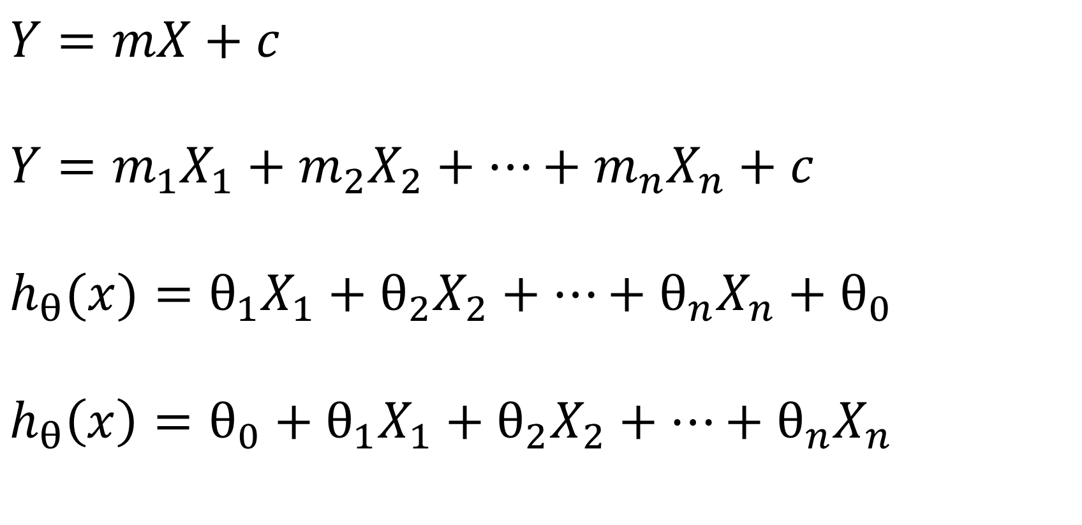
$$Y=mX+c$$
$$Y=m_{1}X_{1}+m_{2}X_{2}+…+m_{n}X_{n}+c$$
$$h_{θ}(x)=θ_{1}X_{1}+θ_{2}X_{2}+…+θ_{n}X_{n}+θ_{0}$$
$$h_{θ}\left(x\right)=θ_{0}+θ_{1}X_{1}+θ_{2}X_{2}+…+θ_{n}X_{n}$$

Slide 10

Linear Regression
Hypothesis: $h(x)$
Parameters: $θ_{0}$, $θ_{1}$, …, $θ_{n}$
Cost function: $J(x)$
Goal: minimize $J(x)$

Slide 11
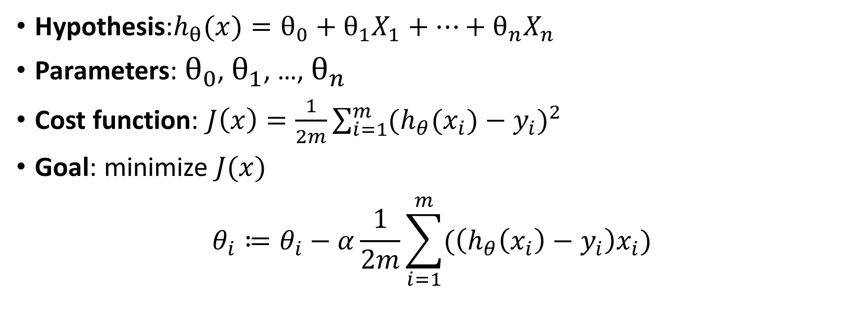
Linear Regression
Hypothesis:$h_{θ}(x)=θ_{0}+θ_{1}X_{1}+…+θ_{n}X_{n}$
Parameters: $θ_{0}$, $θ_{1}$, …, $θ_{n}$
Cost function: $J\left(x\right)=\frac{1}{2m}\sum_{i=1}^{m}{{(h_{θ}(x_{i})−y_{i})}^{2}}$
Goal: minimize $J(x)$
$$θ_{i}≔θ_{i}−α\frac{1}{2m}\sum_{i=1}^{m}{(\left(h_{θ}\left(x_{i}\right)−y_{i}\right)x_{i})}$$
MSE
gradient descent

Slide 12
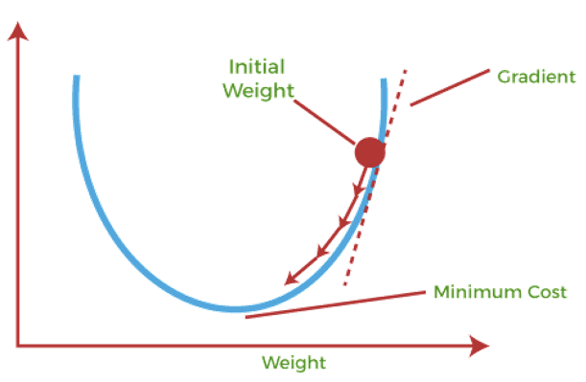
Linear Regression

